Slide 1
Защита критически важных систем от эксплуатации 0-day уязвимостей
Михаил Савушкин

Slide 2
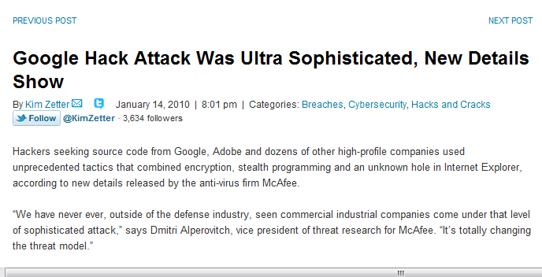


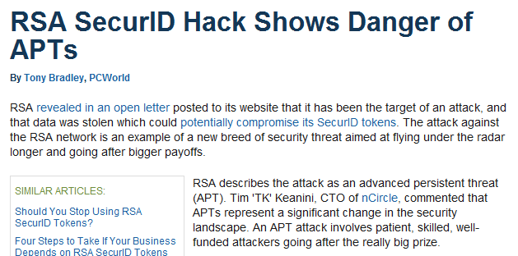
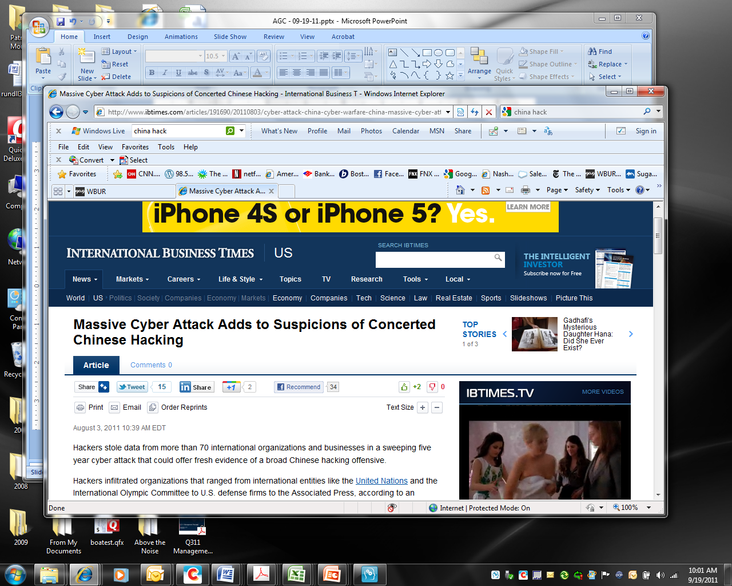
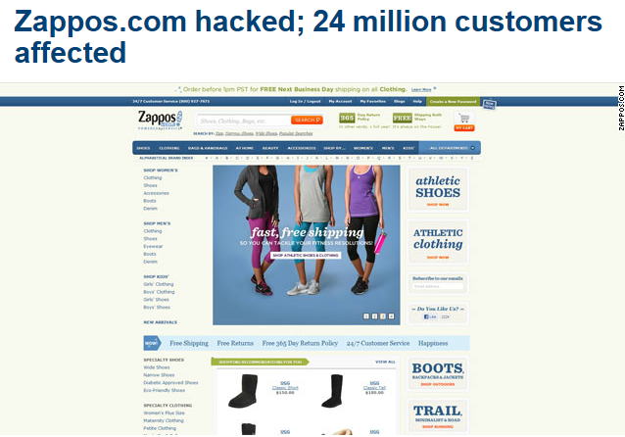
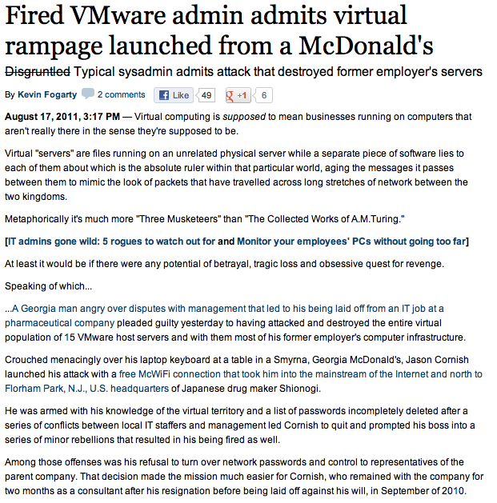
Направление атак хакеров
Популярное направление атаки
- Сервера
Известные атаки
67% проникновений было на серверах
97% украденной информации хранилось на серверах
2012 Verizon Breach Report
Notes:
Over the past few years we have seen a number of large scale data breaches occur. In the majority of these breaches the attack that was performed was not overly sophisticated and in most cases took advantage of vulnerabilities that were not patched or misconfigurations in systems.
Breaches usually target critical assets where intellectual property resides . These critical assets or usually systems that are performing duties like card processing, database servers or file servers that could contain source code or other data that could be sold on the black market
More records are stolen from servers then any other system. The majority of compromises against servers is usually caused from hacking

Slide 3
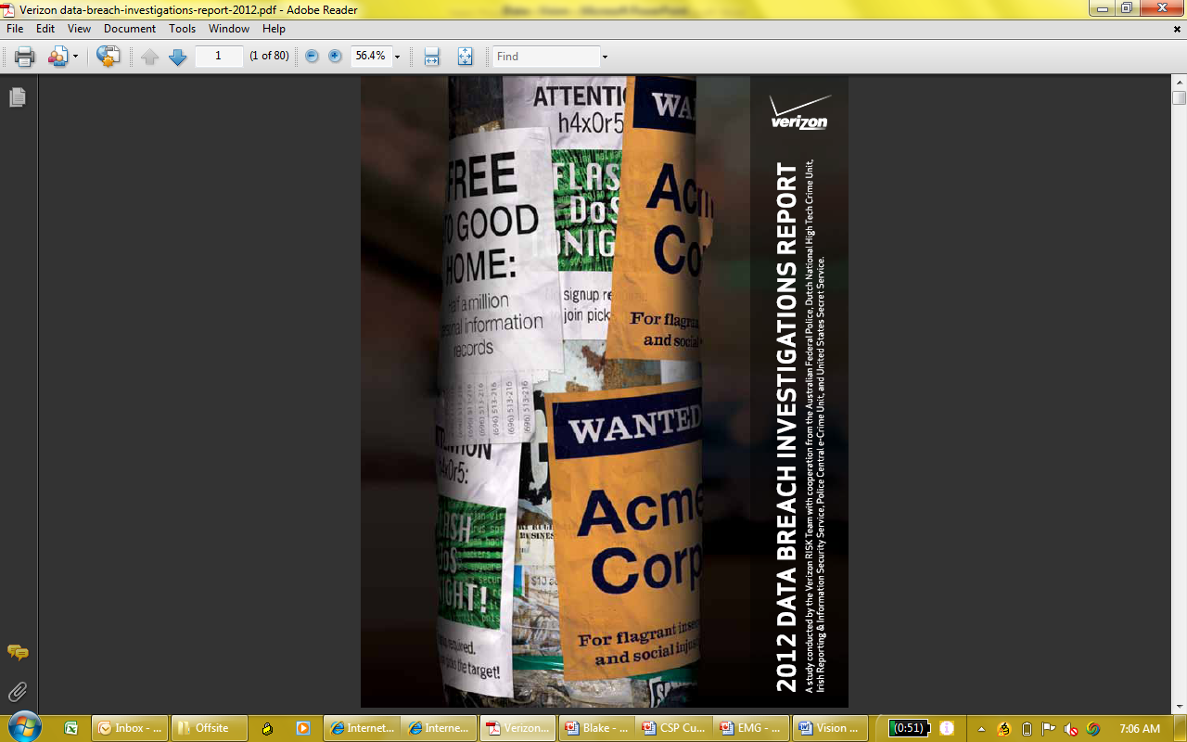
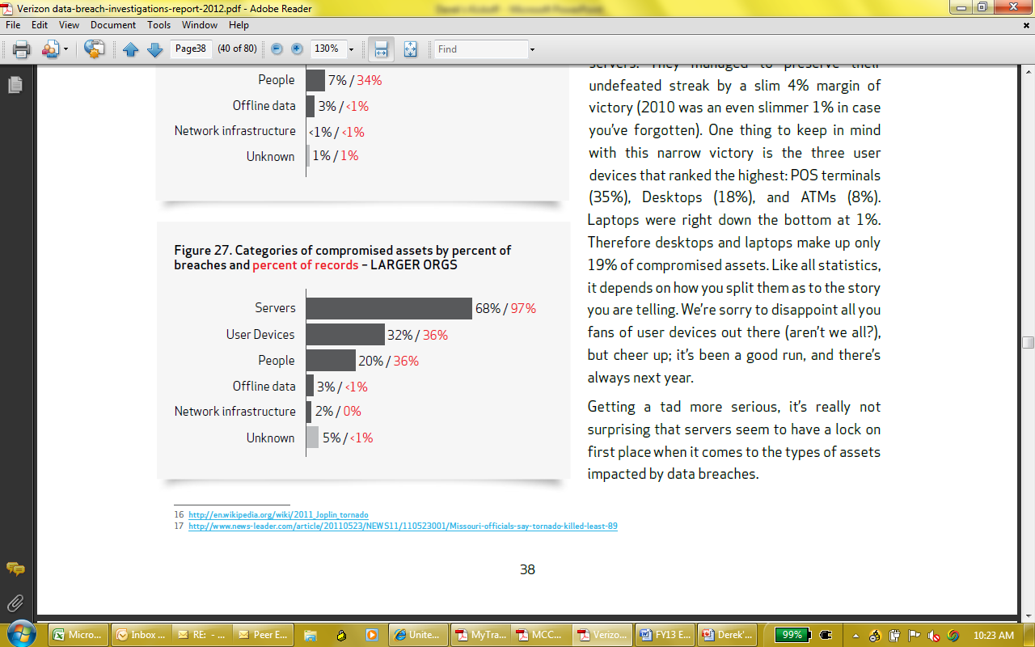
Основная цель – Сервера – рабочие станции обеспечивают “первый шаг” атаки
Categories of Compromised Assets by Percent of Breaches and Percent of Records (Enterprise Cos.)
97%
Информации было украдено с серверов
Verizon 2012 Data Breach Investigations Report: “… More Often Endpoints / User Devices Simply Provide An Initial “Foothold” Into The Organization, From Which The Intruder Stages The Rest Of Their Attack.”
Notes:
Top-5 (% Assets Breached): Web/App Servers (33%), Database Server (33%), ATMs (13%) Desktop/Workstations (12%), Mail Server (10%)
Top-5 (Data Compromised by Breaches): Authentication (35%), Payment Card #s (33%), Personal Info (27%), Org. Info (22%), Sys. Info (15%)
“ …. More often Endpoints simply provide an initial “foothold” into the organization, from which the intruder stages the rest of their attack.”
2012 Report: Covers 855 incidents, 174 million compromised records. Participating Entities: United States Secret Service (USSS), Dutch National High Tech Crime Unit (NHTCU), the Australian Federal Police (AFP), the Irish Reporting & Information Security Service (IRISSCERT), the Police Central e-Crime Unit (PCeU) of the London Metropolitan Police.

Slide 4
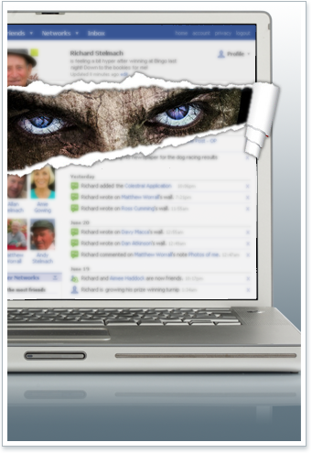
  Проблемы защиты серверов
  риски отсутствия обновлений для приложений
  предотвращение атак нулевого дня и целенаправленных вирусных атак
  контроль “неконтролируемых администраторов”
  неконтролируемые изменения
  актуальная отчетность и критерии безопасности
Notes:
Organizations that were breached could have been avoided if they would have had the right defenses in place. A lot of the breaches happened from carless mistakes or misconfiguration of systems. In the cases where servers where breached because of a vulnerable application , there were usually patches that had been available for a period of time to address it.
Skillful hackers will discover vulnerabilities that have not been identified by vendors to exploit. These vulnerabilities do not have patches so makes them an easy target for the hacker. This type of attack is referred to as a Zero Day Attack
Users with privilege rights on servers can often make mistakes that causes the security of the server to be weakened. The misconfigurations has been one of the leading causes of server breaches over the past few years. You also have to case of admins who become disgruntled and when they are let go, they reach havoc on the environment. This could be anything from a Vmadmin who goes into the Vsphere client and deletes guest to a local admin who deletes data from the server.
A lot of these issues can be avoid with the right type of defense in place.

Slide 5

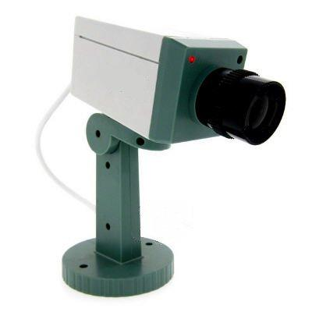
Что за продукт нужен для защиты серверов?
Host Intrusion Prevention
Real-Time Proactive Enforcement
Intrusion/Malware Prevention
System Hardening
Application Control
Privileged User access control
Vulnerability & Patch Mitigation
Безопаснее
Host Intrusion Detection
Real-time Monitoring & Auditing
Host Intrusion Detection
File Integrity Monitoring
Configuration Monitoring
Track and Monitor user access
Logging and Event Reporting
Notes:
There are several vendors that offers products to help mitigate and prevent server compromise from occurring. These types of products are usually referred to as Host Intrusion Protection (HIPS) or Host Intrusion Detection (HIDS).
HIPS products can take different approach to protection systems. One approach is locking down the system to prevent unauthorized applications from getting installed (white listing). Some white listing products will only control what applications can run on the system, but does not control what the trusted application can do on the system. If the trusted application is exploited then the hacker has rights to the system.
Some HIPS products monitor the wire looking for attacks targeting the system and blocking them. These products perform deep packet inspection of every packet that is coming in looking for a signature match. These types of HIPS products can only block what they know and tend to be resource hogs.
HIDS products perform analysis of logs on the system looking for strings or patterns to match on. These strings and patterns are usually written to look for suspicious behavior. Some HIDS products only perform file integrity monitoring . They will monitor files on the system looking for tampering and will alert when a file has changed
The vendors that are out in the market that provide these products will usually only provide one piece or they will require multiple products to provide the full range of protection
Bit 9 - White listing (No Application Control) and File Integrity Monitoring only
McAfee – Requires several products or licenses to perform White listing, Application Control, Configuration Monitoring and File Integrity Monitoring
Trend – Provides FIM, Log Inspection and network protection
CA – Provides FIM, White listing, Application Control

Slide 6
Основные компоненты SCSP
Поведенческий контроль
Контроль системы
Сетевая защита
Аудит
Оповещения
Prevention
Detection
Re
Мониторинг логов и событий безопасности
Объединение логов и передача для хранения и отчетности
Мониторинг целостности файлов в режиме реального времени
Настройка действий по событиям
Ограничение приложений и ОС на основе поведения
Защита от переполнения буфера
Белые списки
Защита от атак нулевого дня
Защита от эксплойтов
Контроль файлов настроек
Применение политик безопасности
Понижение прав пользователей
Ограничение внешних носителей
Защита vSphere
Ограничение доступа приложений в сеть
Ограничение исходящего и входящего трафика
Блокировка бекдоров (блокировка портов)
Notes:
CSP is one of the only products on the market that offers the best set of features to provide real time visibility and maximum control on your servers.
When we break down the main features that CSP provides we can place them into several buckets (Prevention and Detection)
Application Control (Prevention)
When we discuss with customers the capabilities that CSP provides from a protection and prevention point of view it is important to understand how these components work. The Application Control capability of CSP uses polices to control bad behavior on the system as well as which applications can run. These polices are written to control good behavior of the applications and services that are running on the system. If an exploit occurs CSP will detect that the exploit is trying to access a resource or execute a command or modify a executable and prevent that from occurring. If I trust an application to run on the system I do not want someone to use the trust of that application to make modifications to the system. This is much different then applications that only provide white listing capabilities. White listing will control if an application can start, but once the application is started it does not control its behavior.
System Control (Prevention)
CSP prevention capability can also be used to lock down configuration files as well as intellectual property. This help prevent configuration drift or changes to the configuration that could result in a weaker system. CSP can also control user privileges. Even if a user has admin rights, CSP intercepts everything at the kernel level and makes a call on rather to grant that action. CSP can control access to registry, files and directories on the system as well as prevent removable drive use.
Network Protection (Prevention)
The network protection side of prevention can control access to and from the system based on IP and Port. The firewall does not provide deep packet inspection and does not look at any other protocols then TCP and UDP. Firewall rules can be written to control what applications are allowed to communicate and to where. Firewall rules can also be used to control when an application is communicating under what user is it allowed to make those connections.
Auditing and Alerting (Detection) CSP provides file and log inspection. In Real-time CSP will monitor files for changes and will inspect log files for strings and patterns. If CSP detects a change or pattern it will send an event to the CSP MGR for logging, reporting and alerting.
CSP can send out alerts via SMTP and SNMP. CSP provides out of the box queries that can be placed in reports for reporting against the data stored in the database. CSP provides a monitor tab that can be used to view and search on events in real-time.

Slide 7
Основные компоненты SCSP
Поведенческий контроль
Контроль системы
Сетевая защита
Аудит
Оповещения
Prevention
Detection
Re
Мониторинг логов и событий безопасности
Объединение логов и передача для хранения и отчетности
Мониторинг целостности файлов в режиме реального времени
Настройка действий по событиям
Ограничение приложений и ОС на основе поведения
Защита от переполнения буфера
Белые списки
Защита от атак нулевого дня
Защита от эксплойтов
Контроль файлов настроек
Применение политик безопасности
Понижение прав пользователей
Ограничение внешних носителей
Защита vSphere
Ограничение доступа приложений в сеть
Ограничение исходящего и входящего трафика
Блокировка бекдоров (блокировка портов)
Notes:
CSP is one of the only products on the market that offers the best set of features to provide real time visibility and maximum control on your servers.
When we break down the main features that CSP provides we can place them into several buckets (Prevention and Detection)
Application Control (Prevention)
When we discuss with customers the capabilities that CSP provides from a protection and prevention point of view it is important to understand how these components work. The Application Control capability of CSP uses polices to control bad behavior on the system as well as which applications can run. These polices are written to control good behavior of the applications and services that are running on the system. If an exploit occurs CSP will detect that the exploit is trying to access a resource or execute a command or modify a executable and prevent that from occurring. If I trust an application to run on the system I do not want someone to use the trust of that application to make modifications to the system. This is much different then applications that only provide white listing capabilities. White listing will control if an application can start, but once the application is started it does not control its behavior.
System Control (Prevention)
CSP prevention capability can also be used to lock down configuration files as well as intellectual property. This help prevent configuration drift or changes to the configuration that could result in a weaker system. CSP can also control user privileges. Even if a user has admin rights, CSP intercepts everything at the kernel level and makes a call on rather to grant that action. CSP can control access to registry, files and directories on the system as well as prevent removable drive use.
Network Protection (Prevention)
The network protection side of prevention can control access to and from the system based on IP and Port. The firewall does not provide deep packet inspection and does not look at any other protocols then TCP and UDP. Firewall rules can be written to control what applications are allowed to communicate and to where. Firewall rules can also be used to control when an application is communicating under what user is it allowed to make those connections.
Auditing and Alerting (Detection) CSP provides file and log inspection. In Real-time CSP will monitor files for changes and will inspect log files for strings and patterns. If CSP detects a change or pattern it will send an event to the CSP MGR for logging, reporting and alerting.
CSP can send out alerts via SMTP and SNMP. CSP provides out of the box queries that can be placed in reports for reporting against the data stored in the database. CSP provides a monitor tab that can be used to view and search on events in real-time.

Slide 8
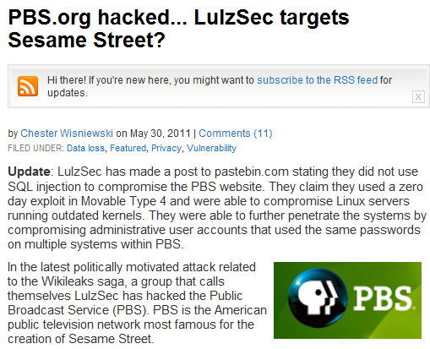
“Использование уязвимости 0 дня для получения доступа
LulzSec
Компрометация других систем,
с помощью полученных паролей
Атаки 0 дня позволяют получить
доступ к запуску команд и
удаленному управлению
Notes:
Vulnerabilities on servers make easy targets to hackers. Once the hacker has compromised the system they can then use that system to launch attack to other systems in the network until they have what they are looking for.
Many customers do not apply patches as often as they should. The has been one of the top causes over the recent years for companies getting hacked.

Slide 9
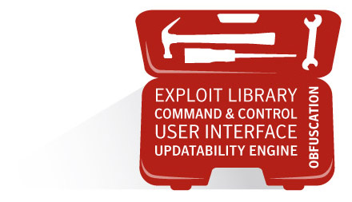
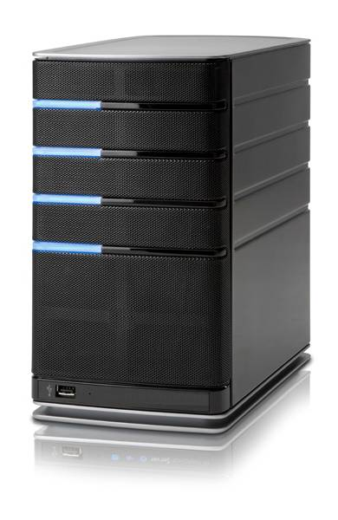
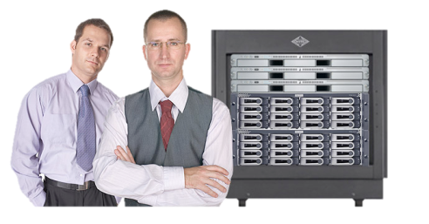
Авторизованные и неавторизованные приложения как «мостик» для компрометации системы
Злоумышленник
Хакеры и Вирусы используя уязвимости получают контроль над системой
Уязвимые приложения могут запускаться с высокими правами
Приложения , запущенные с правами системы или root, позволяют получить полный доступ к системе
Вредоносное ПО устанавливается через доверенное приложение
Сотрудник (инсайдер) устанавливает бекдор
Из удаленной сети с помощью бекдора злоумышленник(сотрудник) получает доступ к системе
Сотрудники
Notes:
In most of the breaches that Verizon investigated hackers where able to infiltrate the environment hack a system and then plant a malware or malicious application on the system. When a system is hacked it is usually from a vulnerable application or brute force password attack. In either case the hacker now has privileged access to the system and can now plant a rootkit, sniffer or keylogger on the system.
In all of these cases the traditional defenses (AV, IPS, Firewalls, etc) did not stop the attack. Either because these systems were looking for a specific known attack or because the hacker had a privileged user account the defense did not stop it.
In other cases where breaches occurred these happened from an insider. This could either be from a disgruntled insider who knows they are about to be laid off and installs a RAT on the system or creates a privileged user account to use at a later time. Once the employee is laid off they use this to gain access back into the enviornment

Slide 10
Поведенческий анализ и Традиционная защита
Традиционный подход
Поведенческий анализ
Re
Черные списки вредоносного ПО - сигнатуры (30 миллионов и более в месяц)
Сигнатуры
Блокировка только того, что знаем
Реактивно
Не защищает от атак 0 дня
Защищает себя от приложений и пользователей
Re
Контроль поведения приложений и ОС на основе поведенческих политик
Поведение / Политики
Блокировка неизвестного
Проактивно
Эффективно для:
  атак 0 дня,
  Защищает ОС от приложений и пользователей
  Защищает приложения друг от друга
VS
Notes:
CSP has the ability out of the box with the Core Prevention Policy to protect the OS from being tampered with malware or vulnerable applications. CSP behavior blocking and containment protects applications and the OS from each other. The policy will contain any bad behavior on the system. Out of the Box the Core Prevention Policy will allow applications to run on the system, but will prevent these applications from making any changes to the OS. Other prevention policies like the Strict or Limited will not only protect the core OS but will offer tighter application protection.

Slide 11
Поведенческий анализ и Традиционная защита
Традиционный подход
Поведенческий анализ
Re
Черные списки вредоносного ПО - сигнатуры (30 миллионов и более в месяц)
Сигнатуры
Блокировка только того, что знаем
Реактивно
Не защищает от атак 0 дня
Защищает себя от приложений и пользователей
Re
Контроль поведения приложений и ОС на основе поведенческих политик
Поведение / Политики
Блокировка неизвестного
Проактивно
Эффективно для:
  атак 0 дня,
  Защищает ОС от приложений и пользователей
  Защищает приложения друг от друга
VS
Notes:
CSP has the ability out of the box with the Core Prevention Policy to protect the OS from being tampered with malware or vulnerable applications. CSP behavior blocking and containment protects applications and the OS from each other. The policy will contain any bad behavior on the system. Out of the Box the Core Prevention Policy will allow applications to run on the system, but will prevent these applications from making any changes to the OS. Other prevention policies like the Strict or Limited will not only protect the core OS but will offer tighter application protection.

Slide 12
CSP использует «песочницы» для ужесточения настроек серверов
Приложения
Большинство программам достаточно ограниченного доступа к ресурсам и прав
НО, большинство программ имеют большие привилегии и права позволяющие атаковать систему
Granular Resource Constraints
Сервисы ОС
Приложения
…
Files
…
Read/Write
Data Files
crond
RPC
Mail
LPD Printer
Web
Registry
Read Only
Configuration
Information
…
Network
Создает «песочницу» для одного или более приложений(процессов)и определяет политику поведения и доступа для данной «песочницы»
RSH Shell
Usage of
Selected Ports
and Devices
Browser
Интерактивные приложения
Devices
Notes:
There are several products in the market place that do traditional white listing. White listing will control what applications can run but do not prevent a trusted application from doing something malicious on the system.
CSP prevention policies provides least privilege application control (LPAC) to all applications running on the system. LPAC controls what applications are allowed and not allowed to do on the system. If an application attempts to access part of the system that it is not suppose to, the attempt is blocked.
Certain applications will run on the system under the system or root account and will have more privileges then what is required. When these applications are exploited the hacker now has root or system access to the system and is able to make changes or install malicious applications.
CSP will sandbox (confine) any sort of bad behavior from an application. If a exploit occurs against a vulnerable application and that exploit tries to access a resource or launch a command shell, LPAC will sandbox that request.
CSP wraps a shim around each application and service. The shim has a set of rules that govern the behavior of that application or service.
CSP can be used as a method of patch mitigation. Patches are usually installed to mitigate a vulnerability found within an application or service. These are the vulnerabilities that allow remote execution or access to resources on the system. CSP LPAC prevents application bad behavior so eliminates a vulnerable application from execution or accessing a system resource

Slide 13
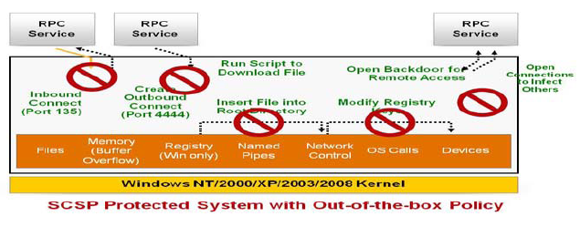
Песочница против атак нулевого дня
Основано на базовых принципах безопасности
Проактивная защита от вредоносного ПО(известного & неизвестного)
Модель удерживания ограничивает риск взлома
Применимо для всего окружения и приложений
Устраняет необходимость установки «заплат»
Защищает ОС от компрометации
Notes:
CSP LPAC can prevent zero day attacks by preventing the malware from accessing resources on the system that it needs to modify for loading or replacing executables. LPAC will prevent the modification of executables as well as preventing important registry keys from modification. When attacks occur and they try and load themselves on the system they will often try and replace system executables and modify registry keys so they can start if the machine is restarted.

Slide 14


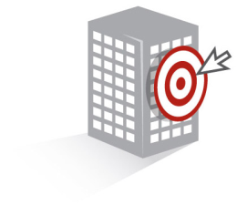
Поведенческий контроль CSP блокирует атаки
ATM
Злоумышленник
Недоверенная пользовательская активность
Неавторизованный процесс пресекается
Поведенческий контроль
Мобильный киоск
Блокируются атаки классов «переполнение буфера» и Thread Injection
Вирус
Notes:
CSP Application Control (LPAC) can prevent a user from installing malicious (unauthorized) applications even if they are being launched by a privileged user. CSP monitors what resources an application is attempting to access and makes a determination if that application should have access to that resource and blocks unauthorized attempts.

Slide 15
Основные компоненты SCSP
Поведенческий контроль
Контроль системы
Сетевая защита
Аудит
Оповещения
Prevention
Detection
Мониторинг логов и событий безопасности
Объединение логов и передача для хранения и отчетности
Мониторинг целостности файлов в режиме реального времени
Настройка действий по событиям
Ограничение приложений и ОС на основе поведения
Защита от переполнения буфера
Белые списки
Защита от атак нулевого дня
Защита от эксплойтов
Контроль файлов настроек
Применение политик безопасности
Понижение прав пользователей
Ограничение внешних носителей
Защита vSphere
Ограничение доступа приложений в сеть
Ограничение исходящего и входящего трафика
Блокировка бекдоров (блокировка портов)
Notes:
CSP is one of the only products on the market that offers the best set of features to provide real time visibility and maximum control on your servers.
When we break down the main features that CSP provides we can place them into several buckets (Prevention and Detection)
Application Control (Prevention)
When we discuss with customers the capabilities that CSP provides from a protection and prevention point of view it is important to understand how these components work. The Application Control capability of CSP uses polices to control bad behavior on the system as well as which applications can run. These polices are written to control good behavior of the applications and services that are running on the system. If an exploit occurs CSP will detect that the exploit is trying to access a resource or execute a command or modify a executable and prevent that from occurring. If I trust an application to run on the system I do not want someone to use the trust of that application to make modifications to the system. This is much different then applications that only provide white listing capabilities. White listing will control if an application can start, but once the application is started it does not control its behavior.
System Control (Prevention)
CSP prevention capability can also be used to lock down configuration files as well as intellectual property. This help prevent configuration drift or changes to the configuration that could result in a weaker system. CSP can also control user privileges. Even if a user has admin rights, CSP intercepts everything at the kernel level and makes a call on rather to grant that action. CSP can control access to registry, files and directories on the system as well as prevent removable drive use.
Network Protection (Prevention)
The network protection side of prevention can control access to and from the system based on IP and Port. The firewall does not provide deep packet inspection and does not look at any other protocols then TCP and UDP. Firewall rules can be written to control what applications are allowed to communicate and to where. Firewall rules can also be used to control when an application is communicating under what user is it allowed to make those connections.
Auditing and Alerting (Detection) CSP provides file and log inspection. In Real-time CSP will monitor files for changes and will inspect log files for strings and patterns. If CSP detects a change or pattern it will send an event to the CSP MGR for logging, reporting and alerting.
CSP can send out alerts via SMTP and SNMP. CSP provides out of the box queries that can be placed in reports for reporting against the data stored in the database. CSP provides a monitor tab that can be used to view and search on events in real-time.

Slide 16
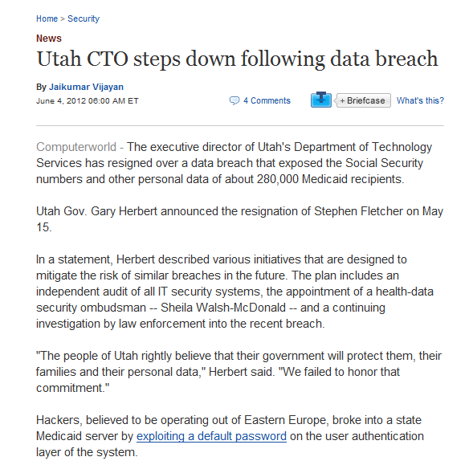
“Ошибки в настройке системы приводят к утечке данных”
Использование стандартных
паролей для предоставления
доступа
Отсутствие шифрования и
полный доступ к серверам
Notes:
In many breaches that have occurred they were successful because of a misconfiguration or a weak password on the server. Verizon reported that a large number of breaches happen because of simple mistakes made by the customer

Slide 17

Некорректные права пользователям- помощь злоумышленникам
Злоумышленник
Злоумышленник или вирус получает доступ к системе
Повышаются права пользователя
Пользователь с завышенными правами вносит изменения в систему
Зараженный сменный носитель подключается к системе сотрудниками обслуживающими систему
Вирус (Stuxnet, Flamer, etc) заражает систему
Сотрудники
Notes:
Hackers want privileged access to a system and will either try and brute force password attack an account that is a privileged user or try and elevate a compromised user account. Once on the system hackers will attempt to make changes to the system to weaken the security, install backdoors.
Resources (file, directory, network connections )are servers should be protected from unauthorized changes. Resources are the primary target of APT’s. APT will target resources in attempt to make changes to them to steal or to make use of for spreading to other systems.
Over the past few years we have seen a number of malware (confiker, stuxnet, Flamer) that would use USB drives as infection points to then move from one system to another.
Removable drives have also been a method that IT Ops or Service techs use to perform software updates on systems espcially systems that are not connected to the internet like ATM, POS or Plant Control systems.

Slide 18
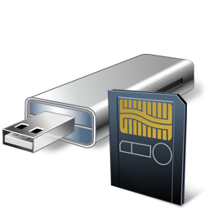
Корректная настройка доступа к системе
Злоумышленник
Недоверенная пользовательская активность
Ресурсы системы защищены от доступа независимо от прав пользователя
Контроль системы
Блокировка сменных носителей
Сменные носители
Notes:
CSP prevention policy provides full control over the resources on the system. This prevents inappropriate user activity like installation unauthorized applications to someone accidently sticking an infected USB drive into the system.

Slide 19
Основные компоненты SCSP
Поведенческий контроль
Контроль системы
Сетевая защита
Аудит
Оповещения
Prevention
Detection
Re
Мониторинг логов и событий безопасности
Объединение логов и передача для хранения и отчетности
Мониторинг целостности файлов в режиме реального времени
Настройка действий по событиям
Ограничение приложений и ОС на основе поведения
Защита от переполнения буфера
Белые списки
Защита от атак нулевого дня
Защита от эксплойтов
Контроль файлов настроек
Применение политик безопасности
Понижение прав пользователей
Ограничение внешних носителей
Защита vSphere
Ограничение доступа приложений в сеть
Ограничение исходящего и входящего трафика
Блокировка бекдоров (блокировка портов)
Notes:
CSP is one of the only products on the market that offers the best set of features to provide real time visibility and maximum control on your servers.
When we break down the main features that CSP provides we can place them into several buckets (Prevention and Detection)
Application Control (Prevention)
When we discuss with customers the capabilities that CSP provides from a protection and prevention point of view it is important to understand how these components work. The Application Control capability of CSP uses polices to control bad behavior on the system as well as which applications can run. These polices are written to control good behavior of the applications and services that are running on the system. If an exploit occurs CSP will detect that the exploit is trying to access a resource or execute a command or modify a executable and prevent that from occurring. If I trust an application to run on the system I do not want someone to use the trust of that application to make modifications to the system. This is much different then applications that only provide white listing capabilities. White listing will control if an application can start, but once the application is started it does not control its behavior.
System Control (Prevention)
CSP prevention capability can also be used to lock down configuration files as well as intellectual property. This help prevent configuration drift or changes to the configuration that could result in a weaker system. CSP can also control user privileges. Even if a user has admin rights, CSP intercepts everything at the kernel level and makes a call on rather to grant that action. CSP can control access to registry, files and directories on the system as well as prevent removable drive use.
Network Protection (Prevention)
The network protection side of prevention can control access to and from the system based on IP and Port. The firewall does not provide deep packet inspection and does not look at any other protocols then TCP and UDP. Firewall rules can be written to control what applications are allowed to communicate and to where. Firewall rules can also be used to control when an application is communicating under what user is it allowed to make those connections.
Auditing and Alerting (Detection) CSP provides file and log inspection. In Real-time CSP will monitor files for changes and will inspect log files for strings and patterns. If CSP detects a change or pattern it will send an event to the CSP MGR for logging, reporting and alerting.
CSP can send out alerts via SMTP and SNMP. CSP provides out of the box queries that can be placed in reports for reporting against the data stored in the database. CSP provides a monitor tab that can be used to view and search on events in real-time.

Slide 20
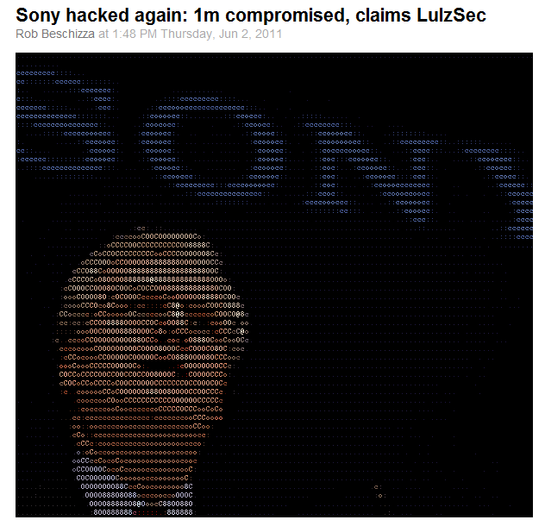
“Отсутствие или неправильный контроль сетевых подключений помогает злоумышленникам”
“Our goal here is not to come across as master hackers, hence what we're about to reveal: SonyPictures.com was owned by a very simple attack”
LulzSec
Notes:
What's worse is that every bit of data we took wasn't encrypted. Sony stored over 1,000,000 passwords of its customers in plaintext, which means it's just a matter of taking it. This is disgraceful and insecure: they were asking for it.

Slide 21
Некорректная настройка межсетевого экрана
Злоумышленник
Хакер или Вирус используюя некорректную настройку (простые гостевые пароли, настройки МСЭ итд) получает доступ к системе
Устанавливаются Сниферы, Кейлогеры, Бекдоры
Вирус используя C&C изменяет код системы и связывается с злоумышленником
С помощью FTP или других протоколов нужные данные из системы передаются злоумышленнику
Credit card
Source Code
Выполняет некорректную настройку МСЭ, оставляя «дыру»
Хакер используя дыру получает доступ к системе
Администратор
Notes:
Many breaches have occurred over the past because of misconfigurations on the firewall that allowed unauthorized traffic to get into the network or servers not properly being segmented.
Many cases once the compromise occurred or a malware infects a system data is lifted from that system back to the hacker or to other systems. Many times servers are allowed to communicate not only on the internal network but to external systems as well without any control of who they can talk to. Many times FTP is allowed to and from these systems which allows for each extract of data.

Slide 22

Корректная настройка правил блокирует атаки
ATM
Злоумышленник
Неавторизованная система
Credit card
Source Code
FTP
Попытка подключения записывается и блокируется
Сетевая защита
Мобильный киоск
Попытка подключения записывается и блокируется
Credit card
Source Code
FTP
Вирус
Notes:
We have seen a lot of PCI breaches over the past few years. Where companies that are suppose to be in compliant with the digital dozen are still compromised. In many cases the system that were compromised were either not segmented from the rest of the network or allowed FTP traffic from that system to the outside world.
CSP network protection can be used to segment traffic from these servers to only other authorized systems in the network as well as prevent FTP or other applications to send data to the outside world.

Slide 23
Основные компоненты SCSP
Поведенческий контроль
Контроль системы
Сетевая защита
Аудит
Оповещения
Prevention
Detection
Re
Мониторинг логов и событий безопасности
Объединение логов и передача для хранения и отчетности
Мониторинг целостности файлов в режиме реального времени
Настройка действий по событиям
Ограничение приложений и ОС на основе поведения
Защита от переполнения буфера
Белые списки
Защита от атак нулевого дня
Защита от эксплойтов
Контроль файлов настроек
Применение политик безопасности
Понижение прав пользователей
Ограничение внешних носителей
Защита vSphere
Ограничение доступа приложений в сеть
Ограничение исходящего и входящего трафика
Блокировка бекдоров (блокировка портов)
Notes:
CSP is one of the only products on the market that offers the best set of features to provide real time visibility and maximum control on your servers.
When we break down the main features that CSP provides we can place them into several buckets (Prevention and Detection)
Application Control (Prevention)
When we discuss with customers the capabilities that CSP provides from a protection and prevention point of view it is important to understand how these components work. The Application Control capability of CSP uses polices to control bad behavior on the system as well as which applications can run. These polices are written to control good behavior of the applications and services that are running on the system. If an exploit occurs CSP will detect that the exploit is trying to access a resource or execute a command or modify a executable and prevent that from occurring. If I trust an application to run on the system I do not want someone to use the trust of that application to make modifications to the system. This is much different then applications that only provide white listing capabilities. White listing will control if an application can start, but once the application is started it does not control its behavior.
System Control (Prevention)
CSP prevention capability can also be used to lock down configuration files as well as intellectual property. This help prevent configuration drift or changes to the configuration that could result in a weaker system. CSP can also control user privileges. Even if a user has admin rights, CSP intercepts everything at the kernel level and makes a call on rather to grant that action. CSP can control access to registry, files and directories on the system as well as prevent removable drive use.
Network Protection (Prevention)
The network protection side of prevention can control access to and from the system based on IP and Port. The firewall does not provide deep packet inspection and does not look at any other protocols then TCP and UDP. Firewall rules can be written to control what applications are allowed to communicate and to where. Firewall rules can also be used to control when an application is communicating under what user is it allowed to make those connections.
Auditing and Alerting (Detection) CSP provides file and log inspection. In Real-time CSP will monitor files for changes and will inspect log files for strings and patterns. If CSP detects a change or pattern it will send an event to the CSP MGR for logging, reporting and alerting.
CSP can send out alerts via SMTP and SNMP. CSP provides out of the box queries that can be placed in reports for reporting against the data stored in the database. CSP provides a monitor tab that can be used to view and search on events in real-time.

Slide 24
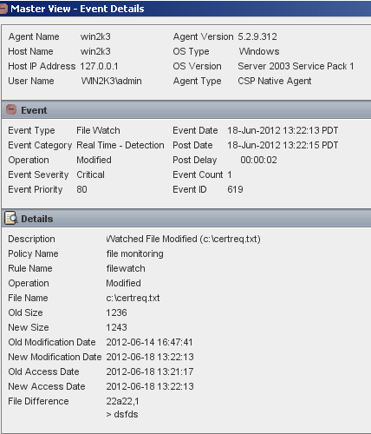
CSP Detection - Мониторинг изменений конфигурации
Отслеживание изменений
File and Registry Change Detection
Security Configuration Changes
Group Management Changes
Active Directory Changes
Shares Configuration Changes
Domain Trust Changes
User/Group Account Modification
Fine Grained System Activity
Malware/Spyware Detection
USB Device Activity
Monitors ESXi host configuration and VMX files
Notes:
CSP provides pre-built detection policies that can monitor OS and application logs files looking for patterns and strings. The pre-built polices look for certain event ID codes and patterns to match on that determines that certain activity is occurring on the system.
CSP detection policies also monitor critical OS and application binary and registry keys. When one of these components is accessed, modified, deleted or created, CSP will alert of the change.

Slide 25


Мониторинг в реальном времени
PCI Section 11: File Integrity Monitoring Requirements (FIM)
SCSP использует мониторинг в режиме реального времени Real-Time File Integrity Monitoring (RTFIM)
Без сканирования, включения аудита в ОС не требуется
Отслеживаются server/file/user name, timestamp, change type, change content, program that made change
Используется SHA256
Функция | FIM | SCSP FIM
Отслеживание изменений в режиме реального времени и оповещение
Требование включенного аудита в Windows
Notes:
CSP takes a hash of a file and monitors to see if that hash changes in real-time. Real-time file integrity monitoring occurs on when the file is on the local fixed disk system. If the file resides on a removable or network share then CSP uses polling. CSP does not require Windows auditing to be enabled. When setting up FIM capability in CSP you can monitor an individual file or you can use wild cards to monitor an entire sub directory and directories underneath it
This is different then some of the competitors (Tripwire) that uses a polling method that is not real-time or requires Windows auditing to be enabled for real-time.
CSP will report on who, what and when a file has changed. It will also display what has changed in the file.

Slide 26
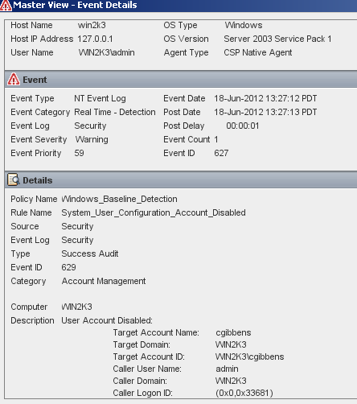
CSP Detection - мониторинг ключевых событий в системе
System/Application Log Monitoring
Мониторинг Входа/ Выхода
  Success, Failures, After Hours, Weekends, privileged user, Unusual access methods, password cracking attempts
Мониторинг Системы/Сервисов
  Service/daemon/driver failures, process tracking (privileged access, unusual usage)
C2 Object Level Log Monitoring
Web Log Monitoring
Мониторинг журналов приложений
  журналы Баз данных
  журналы серверов приложений (например, Esxi)
  журналы утилит безопасности(например, AV)
  журналы Unix shell & sudo
  журналы vSpehere
Notes:
CSP detection polices can monitor all aspects of the system or application. It can monitor for logins or failed login attempts as well as monitor for services that fail to start.
CSP can monitor application log files like IIS and look for activity that indicates a SQL Injection attack , Directory Transversal or URL attacks.

Slide 27



Symantec Server Protection
Un-compromised at Black Hat 2011 and 2012
Proven Security at “Capture The Flag” Challenges
Challenge:
  ‘Flags hidden across un-patched Windows and Linux systems
  Main flag protected with CSP and SEP out-of-the box prevention policy
  50+ skillful hackers/pen-testers from DoD, NSA, DISA, Anonymous, etc.
Attacks Techniques used:
  Backtrack 5 and custom tools used during penetration attempts
  Zero day attack used and stopped on protected system
  Recompiled version of Flamer stopped by CSP out of the box policy
Outcome:
  No one was able to capture the flag… now two years in a row…
  Hackers said if they would have known that Sandboxing and Whitelisting was used, maybe not worth the time they put into it
Notes:
Slide Objective: Demonstrate customer/industry success
Key to this slide is OUT of the BOX policies!
JPMC have been brought up on Whitelisting…(Cigna Cert, app signing, Bit 9….etc.)
SCSP is much easier to manage than those products.
Recently at the BlackHat Technical Security Conference, the Critical System Protection team set up a test allowing anyone to try their luck at retrieving a ‘flag’ hidden on an un-patched XP workstation. The goal was to have security professionals and hackers help Symantec improve the Critical System Protection product by pointing out existing gaps. The flag was secured using Critical System Protection’s out-of-the box strict prevention policies on XP un-patched workstation. The XP workstation, which had 10 known OS vulnerabilities reported by Rapid 7®, was vulnerable to attacks and had open shares that allowed external access.
Hackers and pen testers from various renowned groups like the National Security Agency, Department of Defense, Defense Information Systems Agency and people who claimed to be from the Anonymous hacker group tried but failed to capture the flag.

Slide 28
Сценарии использования

Slide 29

Увеличение срока жизни Windows NT и 2000 с помощью Critical System Protection
Обеспечение безопасности
  Запуск только авторизованного кода на защищаемых системах
    Защита от известных и неизвестных уязвимостей NT
  Обеспечение защиты компонентов приложений
Снижение стоимости
  Нет необходимости устанавливать патчи
    Снижение рисков связанных с установкой патчей
Контроль
Notes:
Because the unexpected happens in business.
Change control and application control reduces the “control gap” and gets you in control of your IT infrastructure to run your business
29

Slide 30
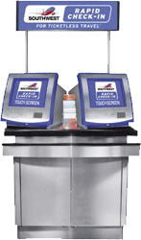
Безопасность мобильных киосков и ATM
С помощью Critical System Protection
Безопасность
  Блокировка неавторизованных приложений
    Защита от вирусов и уязвимостей 0го дня
    Снижение риска компрометации данных
  Эффективно в «закрытых» сетях
Операционная эффективность
  малое влияние на систему
  Отсутствие необходимости обновлять компоненты
Снижение затрат
  Уменьшение отключений устройств
Контроль
Notes:
Because the unexpected happens in business.
Change control and application control reduces the “control gap” and gets you in control of your IT infrastructure to run your business
30

Slide 31
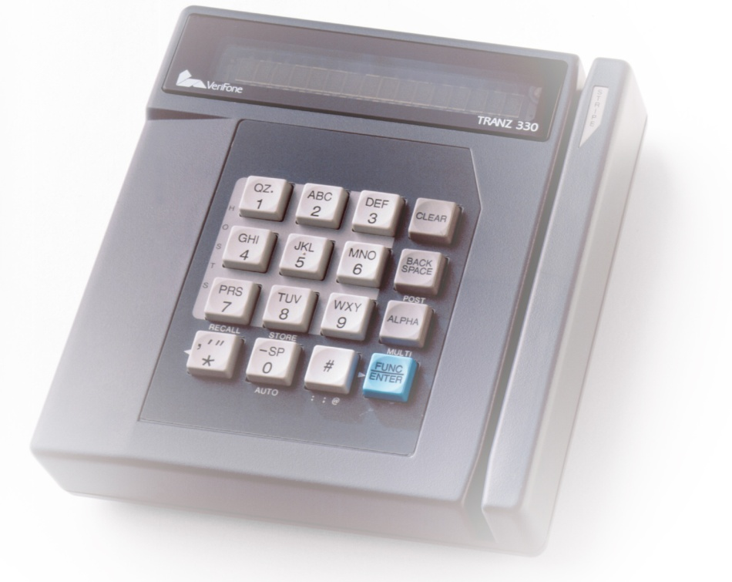
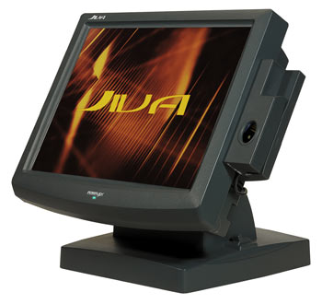
Защита POS терминалов и платежных систем
POS терминалы и платежные системы подвержены атакам
  Данные, используемые при покупке могут использоваться злоумышленниками
Использование уязвимых систем
  Только доверенные приложения должны быть запущенны
«Легкий» агент, для снижения влияния на систему
Payment
Processing
Notes:
31

Slide 32


Критичная инфраструктура
Нуждается в реальной защите
Необходимость защиты от неавторизованного изменения
  SCADA системы, медицинское оборудование итд
  высокая степень надежности
«Легкий» агент, для снижения влияния на систему, отсутствие «лишних» движений
  Установка патчей(ОС, приложений) может быть невозможным
Критичные
системы
Notes:
32

Slide 33
Защита серверов DNS и Контролеров домена
С помощью Critical System Protection
Безопасность
  Блокировка недоверенных приложений
  Сохранение систем в состоянии «золотого» образа
Доступность
  Снижение влияния на системы
    без обновлений сигнатур
Контроль
Notes:
Because the unexpected happens in business.
Change control and application control reduces the “control gap” and gets you in control of your IT infrastructure to run your business
33

Slide 34
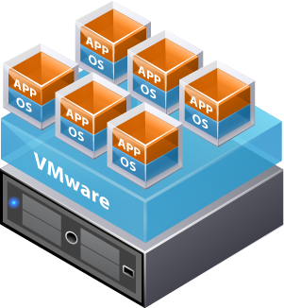

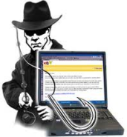

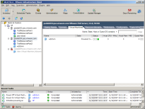
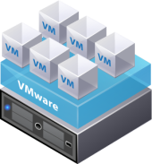



Защита vSphere 5.0
Безопасность
  Защита сервера vCenter , Гостевую систему
  Контроль сетевого доступа и изменения компонентов vSphere
Увеличение видимости
  Обеспечение мониторинга ESXi Host, Guest и vCenter
    Конфигурационные файлы
    Журналы(логи)
vCenter Database
vSphere Client
vCenter Server
Notes:
Because the unexpected happens in business.
Change control and application control reduces the “control gap” and gets you in control of your IT infrastructure to run your business
34

Slide 35

Payment Card Industry (PCI)
Безопасность
  Protects PCI card data
  Protects PCI servers from compromise (Req 5, 11)
  Controls network access to PCI devices (Req 1)
  Limit access to system components (Req 7)
Видимость
  Track and monitor user access (Req 10)
  Use file integrity monitoring (Req 13)
Notes:
35

Slide 36

End of Presentation

